Slide 1

15ECC18 – SENSORS AND ACTUATORS

Slide 2
UNIT II – TEMPERATURE SENSORS AND THERMAL ACTUATORS
Thermo resistive Sensors:
Themistors, Resistance temperature sensors - Silicon resistive sensors –
Thermoelectric Sensors
PN Junction Temperature Sensors
Optical and Acoustical Sensors
Thermo mechanical sensors and Actators.

Slide 3
UNIT II – TEMPERATURE SENSORS AND THERMAL ACTUATORS
The human body and heat
A person consuming 2000 kcal/day, produces 2000*1000*4.184 = 8.368*10⁶ J of energy; to an average power of 8.368*10⁶/24/3600 = 96.85 W.
Hyperthermia - a body core temperature below 35°C.
Hyperpyrexia - Above 41.5°C

Slide 4
UNIT II – TEMPERATURE SENSORS AND THERMAL ACTUATORS
Introduction
History
Thermometers were introduced in the early 1600s, by Robert Boyle.
1700, temperature scales were used, by Lorenzo Magalotti, Carlo Renaldini, Isaac Newton, and Daniel Fahrenheit.
1742, all temperature scales, including the Celsius scale devised by Andres Celsius.
1848, Kelvin proposed the absolute scale.
The establishment of the International Practical Temperature Scale in 1927.

Slide 5
UNIT II – TEMPERATURE SENSORS AND THERMAL ACTUATORS
Introduction
History
Antoine Cesar Becquerel used it in 1826 to build the first modern temperature sensor— the thermocouple.
A second effect related to the Seebeck effect was discovered in 1834 by Charles Athanase Peltier.
William Siemens described in 1871 for measurement of temperature based on the resistance–temperature relation in platinum - Thermoresistive sensors.
Various applications for Temperature Sensor (air velocity, fluid flow, radiation intensity).

Slide 6
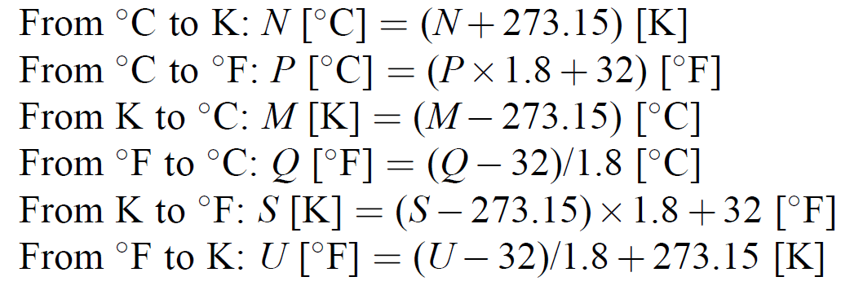
UNIT II – TEMPERATURE SENSORS AND THERMAL ACTUATORS
Introduction
Units of Temperature, Thermal Conductivity, Heat, and Heat Capacity
The SI unit of absolute temperature is the kelvin (K).
The common unit in day-to-day work is the degree Celsius (C).
0°C = 273.15 K and 0 K or 273.15°C.

Slide 7
UNIT II – TEMPERATURE SENSORS AND THERMAL ACTUATORS
Introduction
Units of Temperature, Thermal Conductivity, Heat, and Heat Capacity
Heat is a form of energy.
Its SI derived unit is the joule (J).
megajoules (MJ), gigajoules (GJ), and even terajoules (TJ) are used; nanojoules (nJ) and even attojoules (aJ) are available.
A joule equals a watt-second (1 J = 1Ws) or a newton meter (Nm),
Common use is the kilowatt-hour (kWh) (1 kWh = 3.6 MJ).
Another unit is the calorie (cal).
The calorie is a thermochemical unit equal to 0.239 J.

Slide 8
UNIT II – TEMPERATURE SENSORS AND THERMAL ACTUATORS
Introduction
Units of Temperature, Thermal Conductivity, Heat, and Heat Capacity
Thermal conductivity, denoted as k or λ, is measured in watts per meter per kelvin (W/m/K).
Heat capacity, denoted as C, refers to the amount of heat necessary to change the temperature of a substance by a given amount. SI unit is joule per Kelvin (J/K).
Molar heat capacity is often employed and has units of joules per mole per Kelvin (J/mol/K).
Specific heat capacity (J/kg/K), the amount of heat required to increase the temperature of 1 kg of a substance by 1 K,
Volumetric heat capacity (J/m³/K), the amount of heat needed to increase the temperature of 1 m³ of a substance by 1 K.

Slide 9
THERMORESISTIVE SENSORS
Introduction
Two basic types:
Resistance Temperature Detectors (RTDs) and Thermistors (the name is a concatenation of the words thermal and resistor).
RTDs have come to indicate thermoresistive sensors based on solid conductors, usually in the form of metal wires or films.
Resistance of the sensor increases with temperature—that is, the materials used have
Positive Temperature Coefficients (PTCs) of resistance.
Silicon-based RTDs have higher resistances and higher temperature coefficients.
Thermistors are semiconductor-based devices and usually have a negative temperature coefficient (NTC) of resistance, but PTC thermistors also exist.

Slide 10
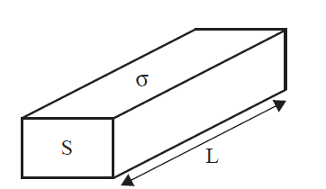
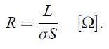
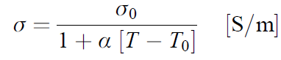
THERMORESISTIVE SENSORS
Resistance Temperature Detectors
The earlier sensors of this type were made of an appropriate metal such as platinum.
Nickel, or Copper, depending on the application, temperature range, and often the cost.
All RTDs are based on the change in resistance due to the temperature.
The resistance of a conductor of length L with constant cross-sectional area S and conductivity σ
The conductivity of the material itself is temperature dependent and given as
where α is the temperature coefficient of resistance of the conductor, T is the temperature, and σ₀ is the conductivity of the conductor at the reference temperature T₀ (20°C).

Slide 11
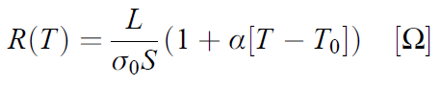
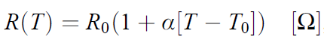
THERMORESISTIVE SENSORS
Resistance Temperature Detectors
The resistance of the conductor as a function of temperature is therefore,
where, R₀ is the resistance at the reference temperature T₀.

Slide 12
THERMORESISTIVE SENSORS
Resistance Temperature Detectors
Example,
Consider, copper, σ₀ = 5.8*10⁷ S/m and α = 0.0039/°C at T₀ = 20°C, area S of 0.1 mm² and length L of 1 m gives,
A change in resistance of 6.61*10⁵ Ω/°C and a base resistance of 0.017 Ω at 20°C. This is a change of 0.38%
A large temperature coefficient is also useful in that the change in resistance is large and hence processing of the signal obtained is easier

Slide 13
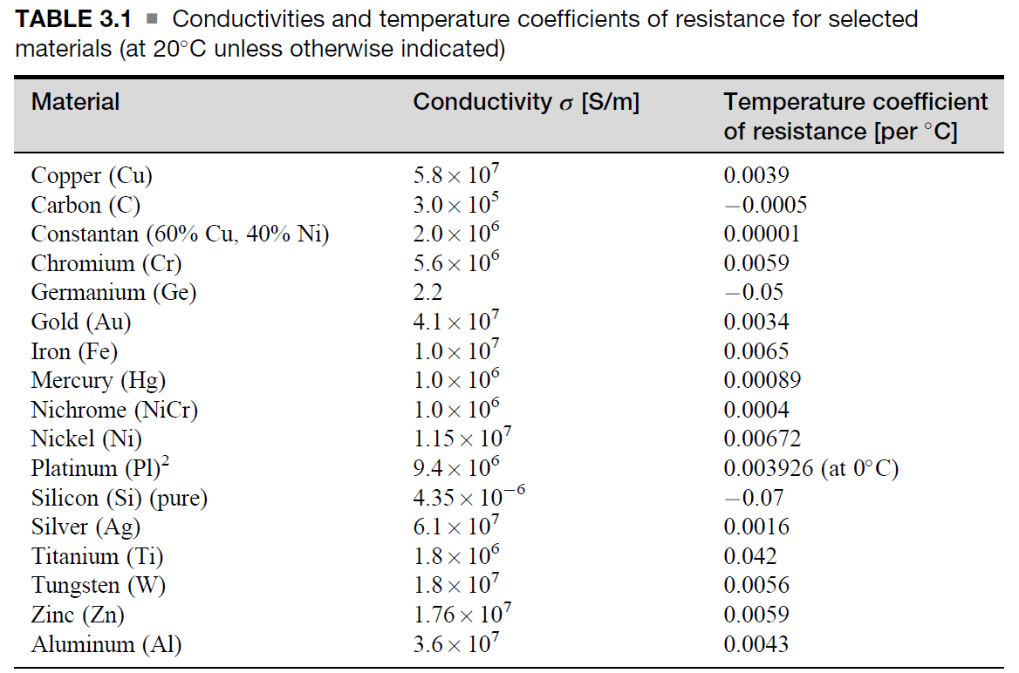
THERMORESISTIVE SENSORS
Resistance Temperature Detectors

Slide 14
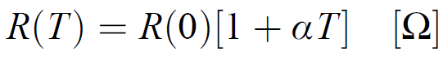
THERMORESISTIVE SENSORS
Resistance Temperature Detectors
The typical data available are the nominal resistance of the RTD, usually given at 0°C, the range between -200°C and +600°C.
Transfer function can be obtained in one of two ways.
The manufacturers conform to existing standards that specify the coefficient α.
Example,
Standard EN 60751, dealing with platinum RTDs, specifies α = 0.00385 (this is sometimes called the ‘‘European curve’’).
Other values are 0.003926 (‘‘American curve’’), 0.003916, and 0.003902,
An approximate transfer function as follows:
R(0) is the resistance at 0°C and T is the temperature

Slide 15
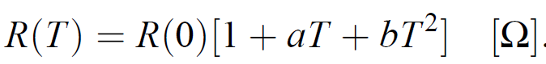
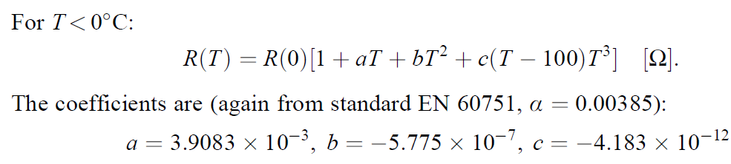
THERMORESISTIVE SENSORS
Resistance Temperature Detectors
To improve on this, the resistance as a function of temperature is calculated based on relations established from the actual measurements
For T> 0°C:
For platinum (standard EN 60751, α = 0.00385), the coefficients are a = 3.9083 *10³, b = -5.775 *10⁷

Slide 16
THERMORESISTIVE SENSORS
Resistance Temperature Detectors
In designing RTDs
Minimize the effect of tension or strain on the wires.
Tensioning a conductor changes its length and cross-sectional area (constant volume).
An increase in strain on the conductor increases the resistance of the conductor.
Changes in temperature cause errors in strain readings and these errors must be compensated for.

Slide 17
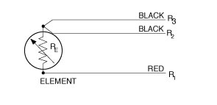
THERMORESISTIVE SENSORS
Resistance Temperature Detectors
Wire RTDs
Has relatively low resistance
High resistances would require very long wires or excessively thin wires
High resistance RTDs require more material, and since most RTDs are based on platinum, material costs can be significant.
Resistance is from a few ohms to a few tens of ohms.
Thin film sensors with higher resistances can be made.
The wire is made of a fairly thin uniform wire wound in a small diameter coil, and the coil is then supported on a suitable support such as mica or glass.
The wire and support may be enclosed in an evacuated glass (typically Pyrex) tube with connecting wires going through the tube or in a highly conductive metal.

Slide 18
THERMORESISTIVE SENSORS
Resistance Temperature Detectors
Precision sensors Wire RTDs
Platinum or platinum alloy is the first choice
Because of its excellent mechanical and thermal properties.
Platinum is chemically stable even at elevated temperatures, it resists oxidation, can be made into thin wires of high chemical purity, resists corrosion, and can withstand severe environmental conditions.
Temperatures up to about 850°C and 250°C.
Platinum is very sensitive to strain and to chemical contaminants, and because its conductivity is high, the wire length needed is long (a few meters).
The resulting sensor is physically large and not suitable for sensing where temperature gradients are high.

Slide 19
THERMORESISTIVE SENSORS
Resistance Temperature Detectors
Less demanding applications (stability and temperature)
Nickel, copper, and other conducting materials offer less expensive alternatives at reduced performance.
Nickel : -100°C to about 500°C (R-T curve is Non-Linear)
Copper :- 100°C to about 300°C (R-T curve is Linear)

Slide 20
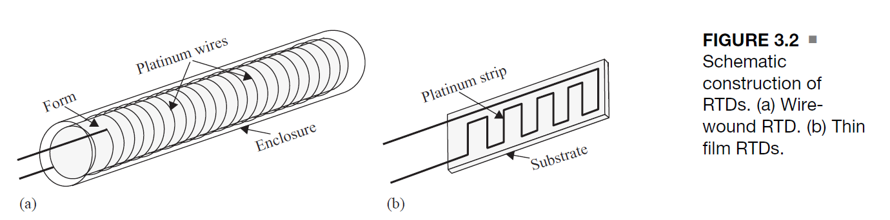
THERMORESISTIVE SENSORS
Resistance Temperature Detectors
Thin film sensors
Produced by depositing a thin layer of a suitable material.
Such as platinum or one of its alloys, on a thermally stable, electrically non-conducting ceramic.
The thin film can then be etched to form a long strip (typically in a meander fashion) and the sensor is potted in epoxy or glass to protect it.
Typical resistance is 100 Ω to 2000 Ω.

Slide 21
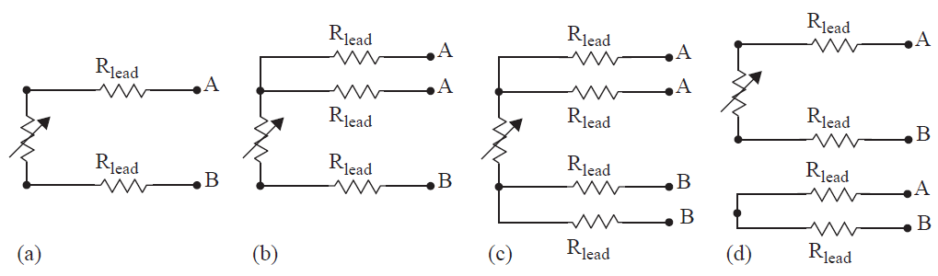
THERMORESISTIVE SENSORS
Resistance Temperature Detectors
Wire RTDs with leads
If the resistance in A-A is subtracted from the total resistance (measured between A-B), one obtains the resistance of the RTD regardless of the resistance of the lead wires.

Slide 22
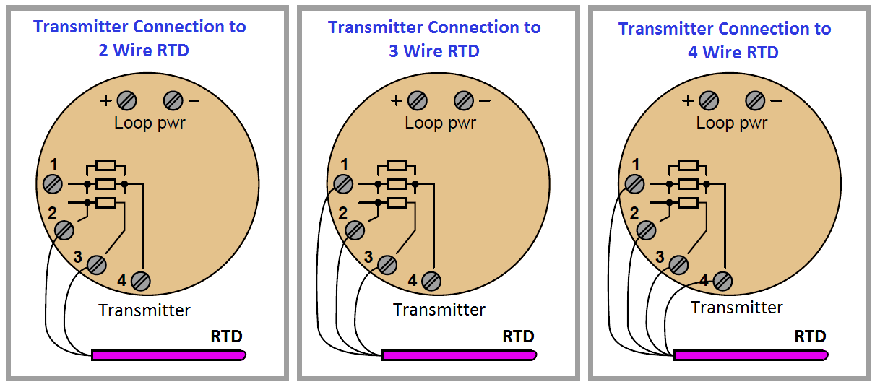
THERMORESISTIVE SENSORS
Resistance Temperature Detectors
Wire RTDs with leads

Slide 23
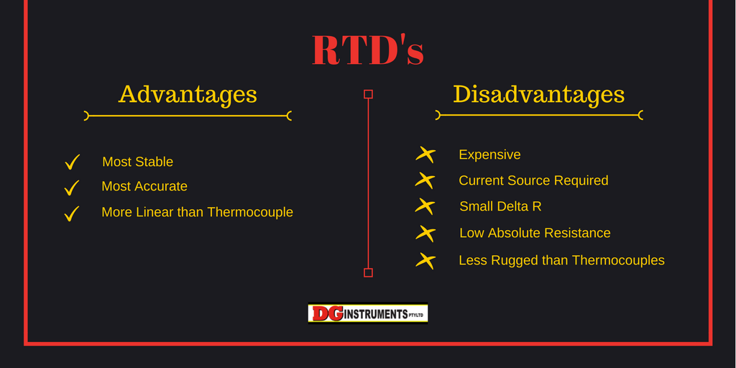
THERMORESISTIVE SENSORS
Resistance Temperature Detectors

Slide 24
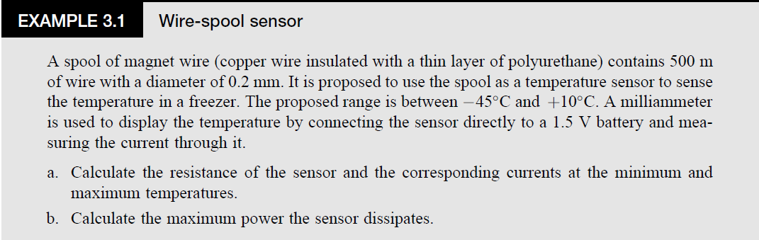

Slide 25
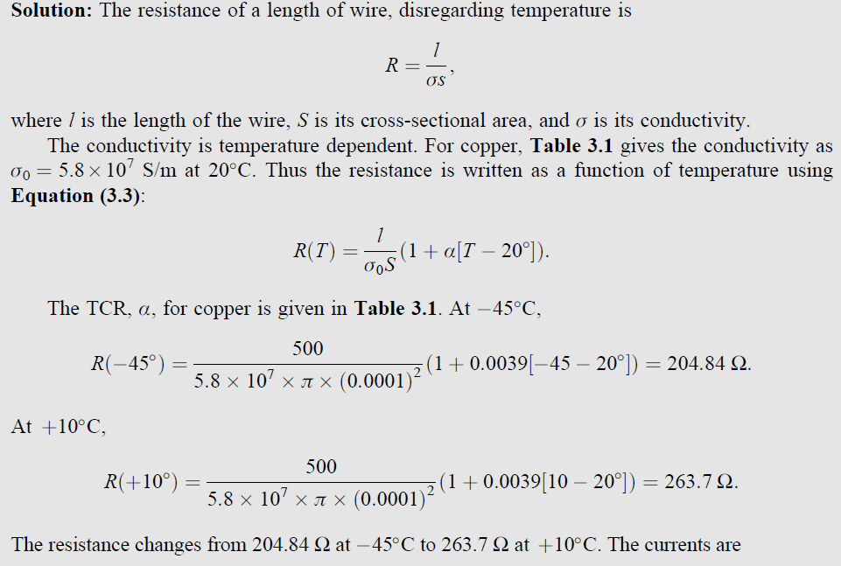

Slide 26
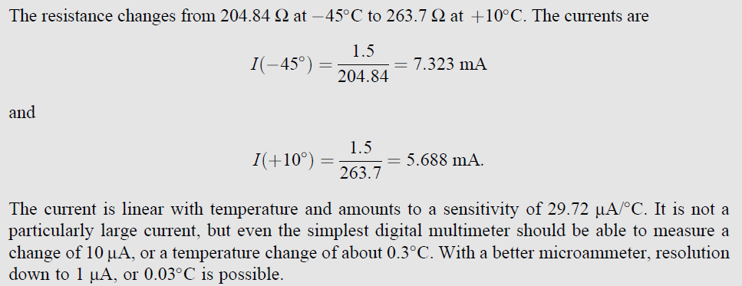

Slide 27
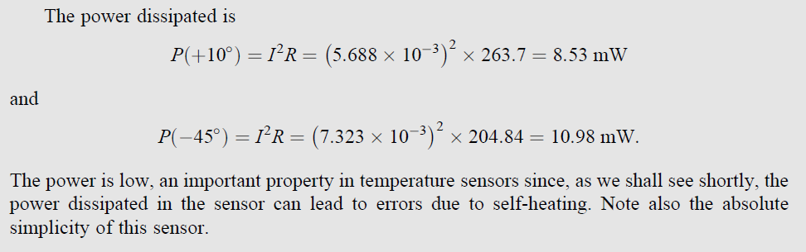

Slide 28
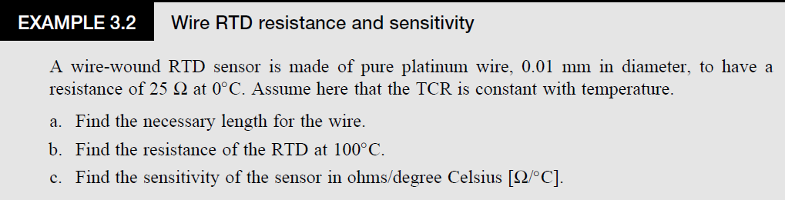

Slide 29
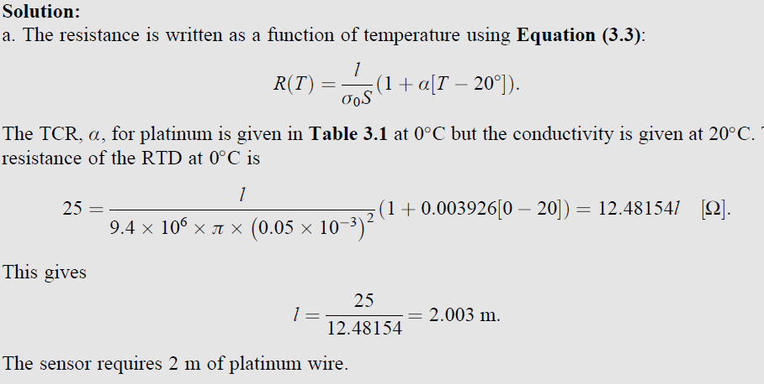

Slide 30
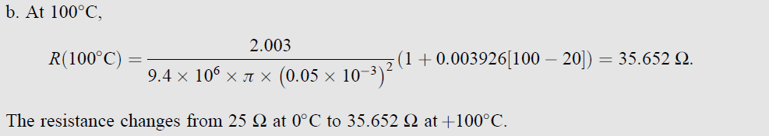

Slide 31
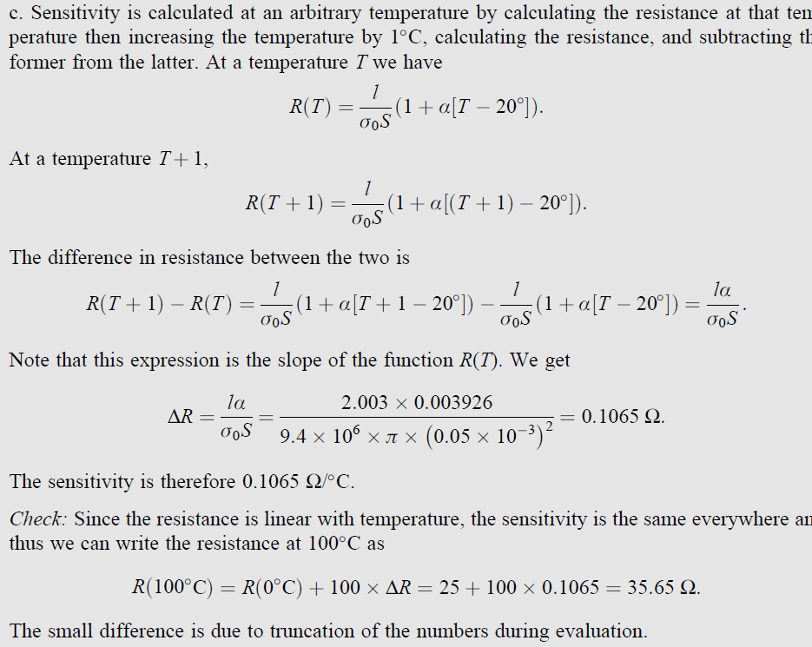

Slide 32
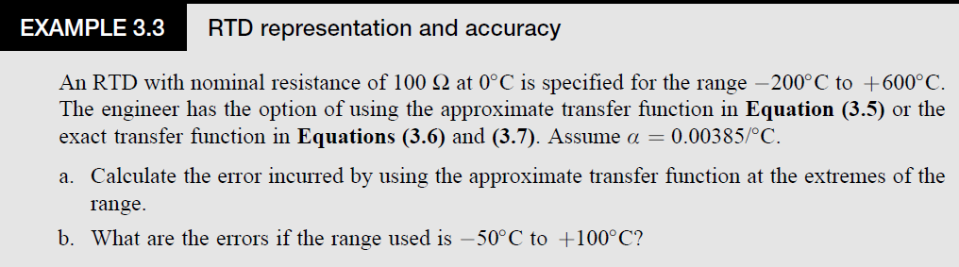

Slide 33
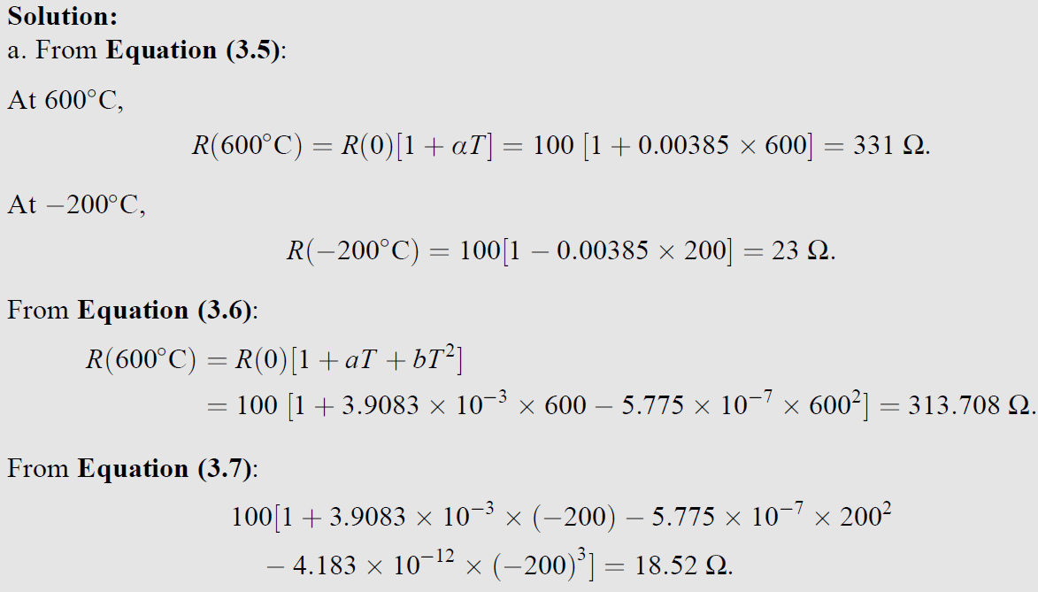
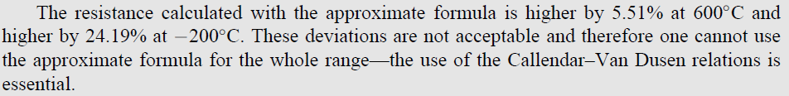

Slide 34
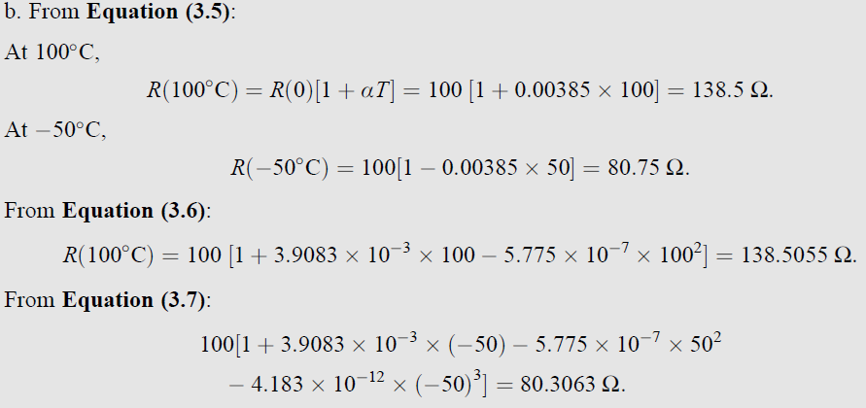

Slide 35
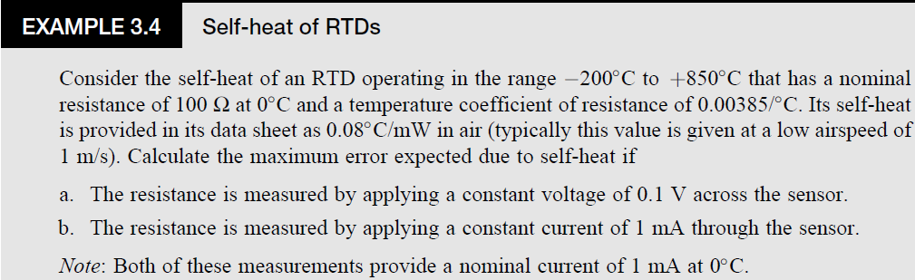

Slide 36
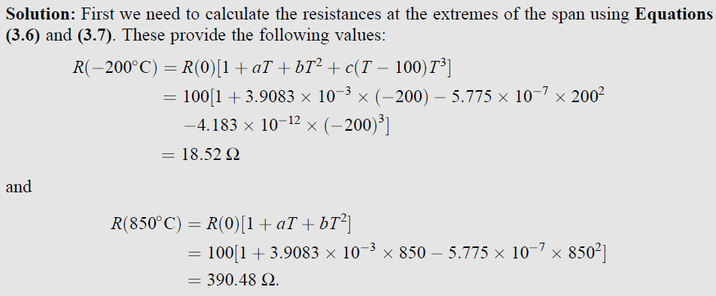

Slide 37
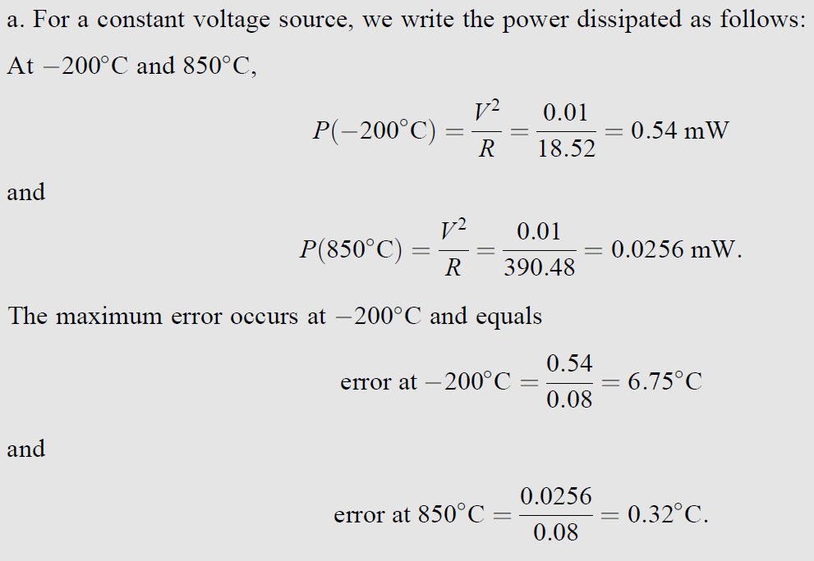

Slide 38
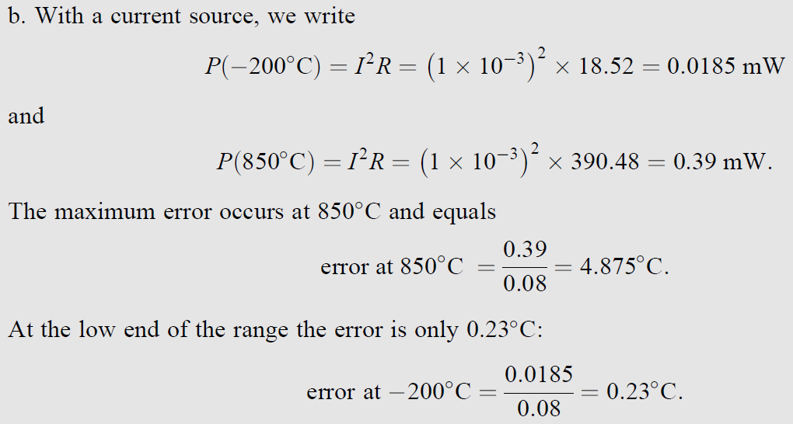

Slide 39
Silicon Resistive Sensors
Valence electrons may be viewed as those bound to atoms and hence not free to move.
Conduction electrons are free to move and affect the current through the semiconductor.
In a pure semiconductor, most electrons are valence electrons and are said to be in the valence band.
An electron to move into the conduction band it must acquire additional energy, and in moving into the conduction band it leaves behind a Hole. This energy is called the band gap energy.

Slide 40
Silicon Resistive Sensors
The additional energy comes from heat.
The higher the temperature, the higher the number of electrons
(and holes) available and hence the higher the current that can flow through the device (i.e., the lower its resistance).
As temperature increases, the resistance decreases and hence pure semiconductors such as silicon typically have negative temperature coefficient (NTC) characteristics.

Slide 41
Silicon Resistive Sensors
Semiconductors are rarely used as pure (intrinsic) materials.
When doping silicon with an n-type impurity such as arsenic or antimony, the reverse effect is observed below a certain temperature.
For n-type silicon, a positive temperature coefficient (PTC) is observed below about 200°C. Above that temperature the properties of intrinsic (pure) silicon predominate and the behavior is NTC.
For practical sensing applications using silicon semiconductor devices, the range of interest is below 200°C.

Slide 42
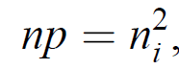
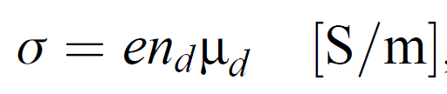
Silicon Resistive Sensors
In an intrinsic material, the concentration of electrons and holes is equal (n = p), but of course in doped materials they are not.
n_{i} is the intrinsic concentration
The conductivity of the semiconductor is
The concentrations of carriers are temperature dependent and that relation is nonlinear.
The conductivity variation with temperature is a useful measure of temperature.
These are called silicon resistive sensors

Slide 43
Silicon Resistive Sensors
Properties:
Silicon resistive sensors are nonlinear and offer sensitivities on the order of 0.5 - 0.7%/°C.
Limited range of temperatures (between -55°C to +150°C).
These sensors are very small, made of a piece of silicon with two electrodes deposited on it and encapsulated, usually in epoxy or glass.
Resistances are on the order of 1 kΩ,
These devices are simple and inexpensive.
Their accuracy is limited (1% - 3%.)

Slide 44
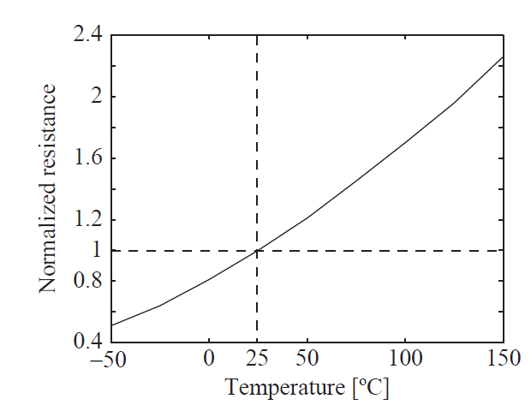
Silicon Resistive Sensors

Slide 45
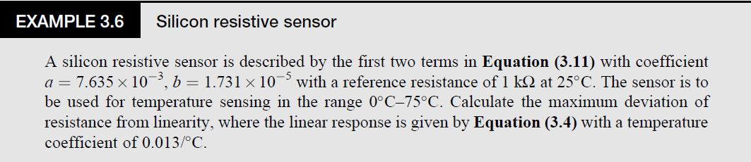
Silicon Resistive Sensors

Slide 46
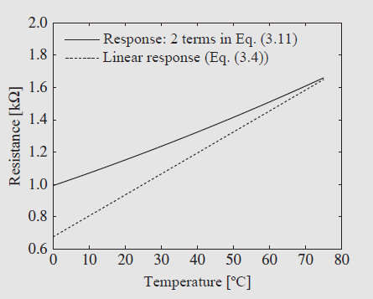
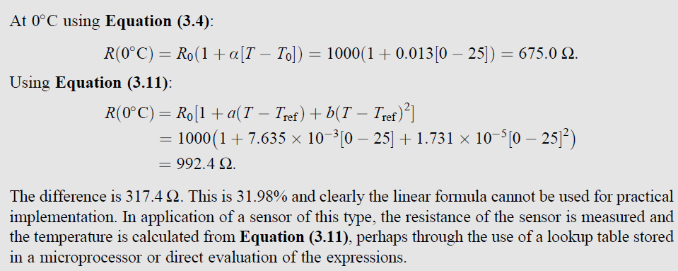
Silicon Resistive Sensors
Response of a silicon resistive sensor showing the deviation between the approximate linear formula and the second-order formula.

Slide 47
Thermistors
Thermistors (thermal resistors) came into existence together with other semiconductor devices and have been used for temperature sensing starting in the 1960s.
These are thermal resistors, made of semiconducting metal oxides that have high temperature coefficients.
Most metal oxide semiconductors have NTCs.

Slide 48
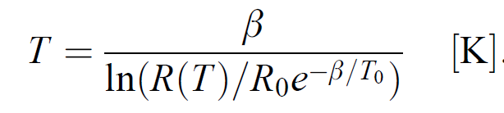
Thermistors
A simple model of a thermistor is
R₀ [Ω] is the resistance of the thermistor at the reference temperature T₀,
β [K] is the material constant
This relation is non-linear.
The inverse relation to previous Equation

Slide 49
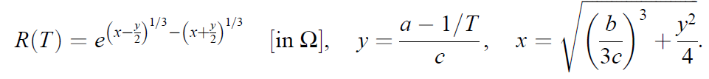
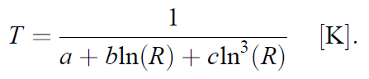
Thermistors
The model in Equation ‘R’ can be improved by using the Steinhart–Hart equation, which gives the resistance as
The constants a, b, and c are evaluated
The inverse relation to previous Equation is

Slide 50
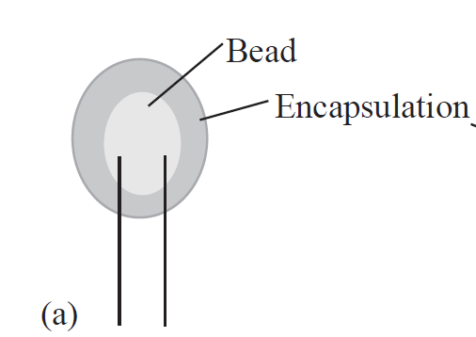
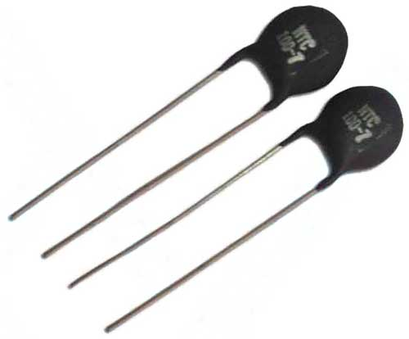
Thermistors
The method of productions
Thermistors are available in higher accuracy models through the processes of trimming the device.
Method: 1
Bead thermistors are essentially a small volume of the metal oxide with two conductors (platinum alloy for high-quality thermistors, copper or copper alloy for inexpensive devices) attached through a heat process.
The bead is then coated, usually with glass or epoxy.
(a) Construction of a bead thermistor.

Slide 51
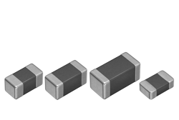
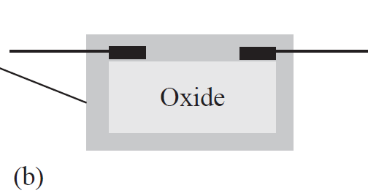
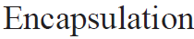
Thermistors
Method: 2
(b) Construction of a chip thermistor.
Another method is to produce chips with surface electrodes that are then connected to leads and the device encapsulated. Chips can be easily trimmed for specific resistance values.

Slide 52
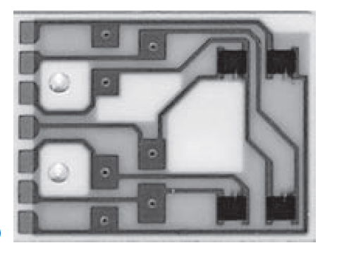
Thermistors
Method: 3
A third method of production is to deposit the semiconductor on a substrate following standard semiconductor production methods.
These are particularly useful in integrated devices and in complex sensors such as radiation sensors.
Deposited thermistors on a ceramic substrate (the thermistors are the four dark, rectangular areas on the right).
While the method of production is important, perhaps more important is the encapsulation, since that is the main means of ensuring long-term stability.
Good thermistors are glass encapsulated,
Epoxy potting is common for less expensive devices.
Stainless steel jackets are added for protection in harsh environments.

Slide 53
Thermistors
Size of the thermistors
The size of the device is also dictated by the production method (with bead thermistors being the smallest) and this dictates the thermal response of the device.
Typically the thermal response of thermistors is relatively short, primarily because of their small physical size.
PTC thermistors
Although most thermistors are NTC devices, PTC devices can also be made from special materials.
These are usually based on barium titanate (BaTiO₃) or strontium titanate (SrTiO₃) with the addition of doping agents.
These materials have very high resistances and a highly nonlinear transfer function.
Unlike NTC thermistors, PTC thermistors have a steep curve in the useful range (large changes in resistance) and are therefore more sensitive than NTCs

Slide 54
Thermistors
PTC thermistors Advantage
All PTC devices (including wire-wound sensors), if connected to a voltage source, as the temperature increases, the current decreases, and therefore they cannot overheat due to self-heating.
This is an intrinsic protection mechanism that can be very useful in high-temperature applications.
NTC thermistors can overheat under the same conditions.
Thermistors Properties
Errors: 0.01°C/mW in water and 1°C/mW in air.
Resistances: Few megaohms with high sensitivity
Currents through thermistors are typically very low
Self-heating is not usually a problem.
Temperature range: - 270°C to 1500°C

Slide 55
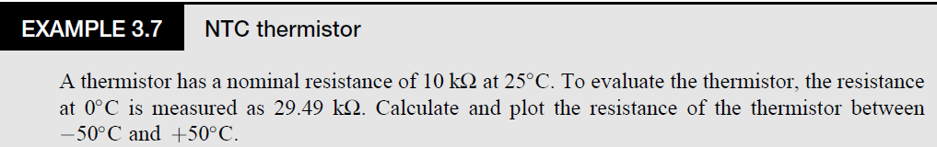

Slide 56
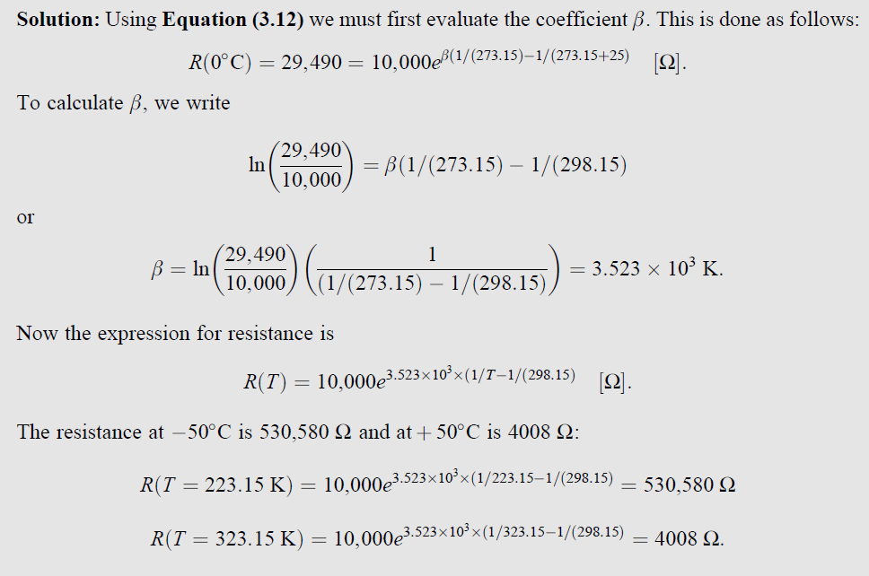

Slide 57
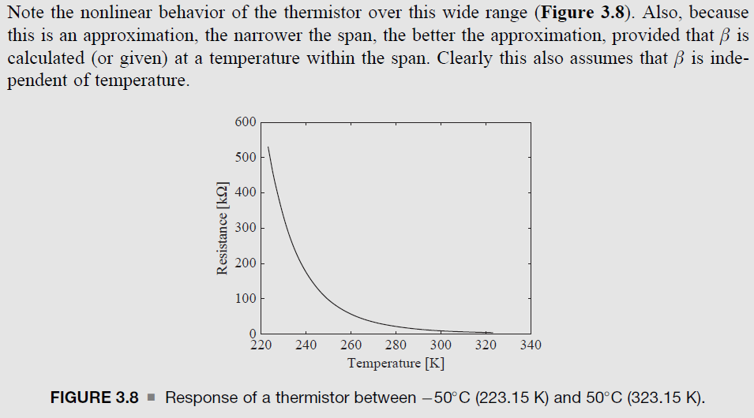

Slide 58
THERMOELECTRIC SENSORS
Thermoelectric sensors are among the oldest sensors.
The signals produced by thermoelectric sensors are small and difficult to measure and are plagued by noise Problems.
these are passive sensors—they generate electric emfs (voltages) directly and hence all one needs to do is measure the voltage.
In addition to being well developed, simple, rugged, and inexpensive, thermoelectric
Sensors can operate on almost the entire practically useful range of temperatures from near absolute zero to about 2700C.

Slide 59
THERMOELECTRIC SENSORS
There is really only one type of thermoelectric sensor, often called a thermocouple.
Thermocouple usually refers to a junction made of two dissimilar conductors.
A number of these junctions connected in series is referred to as a thermopile.
Semiconductor thermocouples and thermopiles have similar functions but also serve in the reverse function, to generate heat or to cool, and can therefore be used as actuators.
These devices are usually called thermoelectric generators (TEGs), or sometimes Peltier cells,

Slide 60
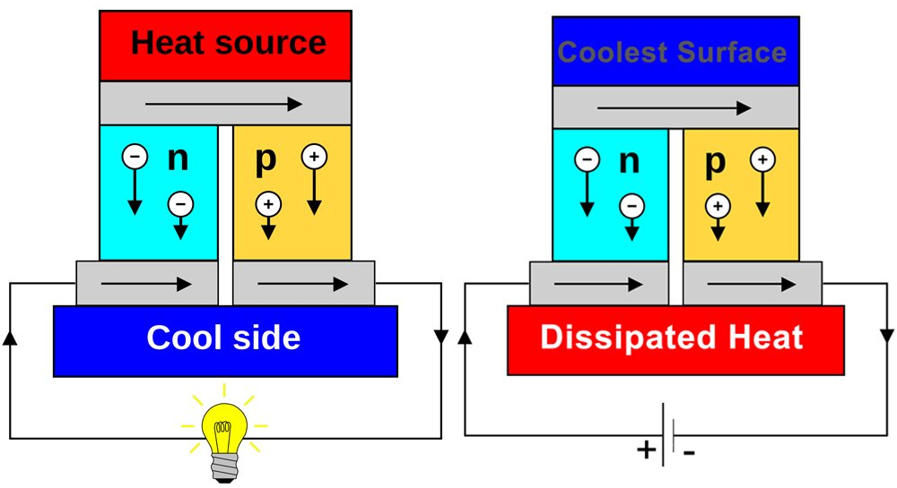
THERMOELECTRIC SENSORS
Thermocouples are based on the Seebeck effect, which in turn is the sum of two other effects—the Peltier effect and the Thomson effect.
Peltier effect
Discovered in 1834 by Charles Athanase Peltier.
The Peltier effect is heat generated or absorbed at the junction of two dissimilar materials when an emf exists across the junction due to current in the junction.
The effect occurs either by connecting an external emf across the junction or it may be generated by the junction itself, depending on the mode of operation.
In either case a current must flow through the junction. This effect has found applications in cooling and heating, particularly in portable refrigerators and in cooling electronic components.

Slide 61

THERMOELECTRIC SENSORS
Thomson effect
The Thomson effect, discovered in 1892 by William Thomson (Lord Kelvin).
It functions such that a current-carrying wire, if unevenly heated along its length, will either absorb or radiate heat depending on the direction of current in the wire (from hot to cold or from cold to hot).

Slide 62

THERMOELECTRIC SENSORS
Seebeck effect
The effect was discovered in 1821 by Thomas Johann Seebeck.
The Seebeck effect is an emf produced across the junction between two dissimilar conducting materials.
If both ends of the two conductors are connected and a temperature difference is maintained between the two junctions, a thermoelectric current will flow through the closed circuit (Figure 3.9a).
Alternatively, if the circuit is opened (Figure 3.9b), an emf will appear across the open circuit. It is this exact emf that is measured in a thermocouple sensor.

Slide 63

THERMOELECTRIC SENSORS
In the simplified analysis, assume that the two junctions in Figure 3.9b are at different temperatures, T₁ and T₂, and the conductors are homogeneous. We can then define the Seebeck emf across each of the conductors, a and b, as
The thermoelectric emf generated by a thermocouple made of two wires, A and B, is therefore,

Slide 64

THERMOELECTRIC SENSORS

Slide 65

THERMOELECTRIC SENSORS

Slide 66
THERMOELECTRIC SENSORS
Operation
The Operation of thermocouples is based on three laws—the thermoelectric laws—
Law of homogeneous circuit: A thermoelectric current cannot be established in a homogeneous circuit by heat alone. This law establishes the need for junctions of dissimilar materials since a single conductor is not sufficient to establish an emf and hence a current.
Law of intermediate materials: The algebraic sum of the thermoelectric forces (emfs) in a circuit composed of any number and combination of dissimilar materials is zero if all junctions are at the same temperature. This establishes the fact that additional materials may be connected in the thermoelectric circuit without affecting the output of the circuit as long as any junctions added to the circuit are kept at the same temperature. Also, the law indicates that voltages are additive so multiple junctions may be connected in series to increase the output (thermopiles).
Law of intermediate temperatures: If two junctions at temperatures T₁ and T₂ produce Seebeck voltage V₂ and temperatures T₂ and T₃ produce Seebeck voltage V₁, then temperatures T₁ and T₃ produce Seebeck voltage V₃ = V₁+V₂. This law establishes methods of calibration for thermocouples.

Slide 67

THERMOELECTRIC SENSORS
Operation
Based on the principles described above, thermocouples are usually used in pairs (but there are exceptions and variations) so that one junction is at the sensing temperature while the second is at a reference temperature, usually a lower temperature, but it can also be a higher temperature.
A measuring thermocouple (hot junction 2) and reference thermocouple (cold junction 1) and additional junctions introduced by connections.

Slide 68
THERMOELECTRIC SENSORS
Operation
The voltmeter represents the device to which the sensor is connected (usually an amplifier).
Any connection in the circuit between dissimilar materials adds an emf due to that junction.
However, any pair of junctions at identical temperatures may be added without changing the output.
The output is produced by junctions (1) and (2) for the following reason: junctions (3) and (4) are identical (one between material b and c and one between material c and b) and their temperature is the same. Thus no net emf due to this pair is produced.
Junctions (5) and (6) also produce zero emf since they are junctions between identical materials that produce zero emf at any temperature.
Note:
Each connection (to the reference junction and to the measuring instrument) necessarily adds two junctions.
It is a good precaution to use unbroken wires leading from the sensor to the reference junction or to the measuring instrument.
If splicing is necessary to extend the length, identical wires must be used to avoid additional emfs.

Slide 69

THERMOELECTRIC SENSORS
Operation
(a) Connection of a thermocouple through a uniform temperature zone (T) and a compensation circuit to replace the reference junction.

Slide 70
THERMOELECTRIC SENSORS
Operation
The two junctions (between material b and c and between material a and c) are placed in a so called uniform temperature zone or isothermal zone.
This can be a small junction box or may in fact be just two junctions in very close proximity.
In this case there is no cold junction, but a compensation circuit is added to ensure that the potentials on the junction b–c and a–c, together with the compensation potential, ‘‘simulate’’ the effect of the cold junction.
The compensation circuit guarantees that the output is zero at the reference temperature (usually 0°C).

Slide 71
THERMOELECTRIC SENSORS
Operation
If a reference junction as in Figure 3.10 is used, it is critical that the temperature is known and constant.
In such cases the temperature of the reference junction may be measured separately by a sensor (usually an RTD, a thermistor) and the reading used to compensate for any change in the temperature of the reference junction.
The reference junction may be held at the temperature of a water–ice mixture that guarantees a temperature of 0°C.
An alternative to the ice–water mixture is boiling water, with the same precautions being taken.
The method in Figure 3.11a is used, which does not require a reference junction or a fixed temperature and hence avoids the errors involved in the use of a reference junction.
Require measurement of the temperature in the temperature zone and a compensation circuit that supplies the equivalent emf expected from the reference junction.

Slide 72


THERMOELECTRIC SENSORS
EMF Equation
The measured emf in Figure 3.11a is
and
may be written in terms of the absolute Seebeck coefficients of the three materials as
the emf supplied by the compensation circuit must be,

Slide 73

THERMOELECTRIC SENSORS
Operation
(b) The compensation circuit
To understand the method of compensation, consider Figure 3.11b.
The cold junction is replaced with a potential difference V_{BA}. The resistance R₁ is selected to equal the resistance of the RTD at 0°C, denoted as R_{T}. The resistors R₂ are equal and are selected to produce a potential difference per degree Celsius as required by the type of thermocouple being used.
Typically the RTD is a platinum RTD with a resistance around 100 Ω and the reference potential V⁺ is regulated at an arbitrary level, but typically between 5 V and 12 V.

Slide 74



THERMOELECTRIC SENSORS
Operation
The potential at point A is
The potential at point B is temperature dependent as
The reason for this is that the compensation circuit is designed to produce zero emf at the reference temperature of the RTD (as can be verified from the equations above and from Figure 3.11b).
As long as the temperature range is relatively small, the method is very accurate (see Example 3.8).

Slide 75


THERMOELECTRIC SENSORS
Types

Slide 76

THERMOELECTRIC SENSORS
Practical Considerations
The choice of materials used to make the junctions is an important consideration that affects the output emf, temperature range, and resistance of the thermocouple.
To aid in the selection of thermocouples and thermocouple materials, the thermocouple reference tables have been established and are supplied by standards organizations.
Thermoelectric series table
Each material in this table is thermoelectrically negative with respect to all materials above it and positive with respect to all materials below it.

Slide 77

THERMOELECTRIC SENSORS
Practical Considerations

Slide 78

THERMOELECTRIC SENSORS
Practical Considerations

Slide 79
THERMOELECTRIC SENSORS
Practical Considerations
The second standard table lists the Seebeck coefficients of various materials with reference to platinum 67 and of various common thermocouple types.
In these tables the first material in each type (E, J, K, R, S, and T) is positive and the second is negative.
For example In Table 3.5, J-type thermocouples use iron and constantan. Thus column JP lists the Seebeck emf for iron with respect to platinum 67, whereas JN lists the emfs for constantan with respect to platinum 67.
Adding the two together gives the corresponding value for the J-type thermocouple in Table 3.6.
Thus, for example, taking the JP and JN values at 0°C in Table 3.5 and adding them, 17.9 + 32.5 = 50.4 µV/°C, gives the entry in the J column at 0C in Table 3.6.

Slide 80

THERMOELECTRIC SENSORS
Practical Considerations
The third table, called the thermoelectric reference table, gives the thermoelectric emf produced by the thermocouple (in effect, this is the transfer function) for each type of thermocouple as an nth-order polynomial in a range of temperatures.

Slide 81
THERMOELECTRIC SENSORS
Practical Considerations
The standard tables provide the emf with a reference junction at 0°C. These tables ensure accurate representation of the thermocouple’s output and can be used by the controller to accurately represent the temperature sensed by the thermocouple.
There are in fact two tables.
One provides the thermocouple output (with reference to zero temperature), whereas the second provides the temperature corresponding to an output emf.

Slide 82

THERMOELECTRIC SENSORS
Practical Considerations

Slide 83

THERMOELECTRIC SENSORS
Practical Considerations

Slide 84

THERMOELECTRIC SENSORS
Practical Considerations

Slide 85

THERMOELECTRIC SENSORS
Practical Considerations

Slide 86

THERMOELECTRIC SENSORS
Problems

Slide 87



THERMOELECTRIC SENSORS
Solution

Slide 88



THERMOELECTRIC SENSORS
Solution

Slide 89

THERMOELECTRIC SENSORS
Semiconductor Thermocouples
As can be seen from Table 3.2, semiconductors such as p and n silicon (p-doped and n-doped silicon) have absolute Seebeck coefficients that are orders of magnitude higher than those of conductors.
The advantage of using semiconductors lies primarily in the large emf that develops at the junction of an n or p semiconductor and a metal (typically aluminum) or at the junction between an n and a p material.
Limitations:
They suffer from one major shortcoming—the range of temperatures at which they are useful is limited.
Silicon in general cannot operate below -55°C or above about 150°C.

Slide 90
THERMOELECTRIC SENSORS
Semiconductor Thermocouples
Alternatives:
Semiconductors such as bismuth telluride (Bi2Te3) that extend the range to about 225°C, and newer materials can reach about 800°C.
Semiconductor thermocouples are used either in thermopiles for sensing or in thermopiles designed for cooling and heating (Peltier cells).
Peltier cells can be used as sensors since their output is directly proportional to the temperature gradient across the cells. As far as their properties and use are concerned, they are similar to other semiconductor thermocouples.

Slide 91

THERMOELECTRIC SENSORS
Thermopiles and Thermoelectric Generators
A thermopile is an arrangement of a number of thermocouples so that their emfs are connected in series.
The purpose of this arrangement is to provide much higher outputs than are possible with single junctions.

Slide 92
THERMOELECTRIC SENSORS
Thermopiles and Thermoelectric Generators
The electrical outputs are in series, the thermal inputs are in parallel (all cold junctions are at one temperature and all hot junctions are at a second temperature).
If the output of a single junction pair is emf₁, and there are n pairs in the thermopile, the output of the thermopile is n×emf₁.
Metal based thermopiles are used both as sensors and as electricity generators. A very common thermopile sensor used in gas furnaces to detect the pilot flame has a nominal output of 750 mV (0.75 V) and uses a few dozen thermocouples to operate at temperatures up to about 800°C.
In gas-fired generators for the purpose of generating electricity for small, remote installations.

Slide 93
THERMOELECTRIC SENSORS
Thermopiles and Thermoelectric Generators
Semiconductor thermopiles made of crystalline semiconductor material such as bismuth telluride (Bi2Te3) are being used in Peltier cells for cooling and heating in dual purpose refrigerators/heaters.
These can also be used as sensors and can have output voltages of a few volts.
In this type of semiconductor thermopile, the base semiconductor is doped to make a junction between an n- and p-type material and processed to yield oriented polycrystalline semiconductors with anisotropic thermoelectric properties.
Because the junctions are small, hundreds of pairs may be built into a single device to produce outputs on the order of 20 V or more.

Slide 94

THERMOELECTRIC SENSORS
Thermopiles and Thermoelectric Generators
FIGURE 3.15 (a) Various Peltier cells. (b) Detail of the construction of a Peltier cell.
Figure 3.15a shows a number of thermoelectric devices (Peltier cells) designed primarily for cooling electronics components such as computer processors.
Figure 3.15b shows the internal construction where the cold junctions are connected thermally to one ceramic plate and the hot junctions are connected to the opposite plate.
The junctions are connected in series in rows. The number of junction pairs can be quite high—typically 31, 63, 127, 255, etc.
A typical cooling cell operating at 12 V (or generating 12 V nominal) will contain 127 junctions. Reversing the current in a cooling device will produce heating.

Slide 95

p-n JUNCTION TEMPERATURE SENSORS
Operation
Schematic of a p-n junction.
The symbol of the junction as a diode.
Forward biasing of the diode.
Reverse biasing of the diode.

Slide 96
p-n JUNCTION TEMPERATURE SENSORS
Operation
When a p-n junction is forward biased, the current through the diode is temperature dependent.
This current can be measured and used to indicate temperature.
Alternatively, the voltage across the diode can be measured (almost always a preferable approach) and its dependence on temperature used as the sensor’s output.
This type of sensor is called a p-n junction temperature sensor or bandgap temperature sensor.

Slide 97

p-n JUNCTION TEMPERATURE SENSORS
Operation
I-V characteristics of a silicon diode.

Slide 98


p-n JUNCTION TEMPERATURE SENSORS
Operation
Assuming that the junction is forward biased, the I-V characteristic is described by the following relation:
Where,
I₀ is the saturation current (a small current, on the order of a few nanoamps, dominated by temperature effects),
q is the charge of the electron, k is Boltzmann’s constant, and T is the absolute temperature (K).
n is a constant between 1 and 2 depending on a number of properties including the materials involved and may be viewed as a property of the device.
In junction temperature sensors, the current I is reasonably large compared with I₀, so that the term -1 can be neglected.
so a good approximation to the forward current in a diode is

Slide 99

p-n JUNCTION TEMPERATURE SENSORS
Operation
The voltage across the diode is both easier to sense and more linear.
where
E_{g} is the bandgap energy (in joules) of the material.
C is a temperature-independent constant for the diode,
I is the current through the junction.
The slope (dV/dT) for silicon it is between 1.0 and 2.5 mV/°C

Slide 100

p-n JUNCTION TEMPERATURE SENSORS
Potential drop on a forward-biased p-n junction versus temperature

Slide 101

p-n JUNCTION TEMPERATURE SENSORS
In using a diode as a temperature sensor, a stable current source is needed.
In most practical applications a voltage source with a relatively large resistor may be used, as in Figure, to bias the junction and establish a small current on the order of 100– 200 microA.
Because Vf is not constant with temperature, this method of biasing is only sufficient for general purpose applications or when the sensing span is small.
Forward-biased p-n junction with a rudimentary current source. R must be large to produce a low current and small variations with variations in V.

Slide 102


p-n JUNCTION TEMPERATURE SENSORS
Junction temperature sensors.

Slide 103


p-n JUNCTION TEMPERATURE SENSORS
Solution

Slide 104

p-n JUNCTION TEMPERATURE SENSORS
Solution

Slide 105

p-n JUNCTION TEMPERATURE SENSORS
Solution

Slide 106

p-n JUNCTION TEMPERATURE SENSORS
Solution

Slide 107
OTHER TEMPERATURE SENSORS
General
Almost all physical quantities and phenomena that can be measured are temperature dependent and therefore, in principle, a sensor can be designed around almost any of these.
For example,
the speed of light and/or its phase in an optical fiber,
the speed of sound in air or a fluid,
the frequency of vibration of a piezoelectric membrane,
the length of a piece of metal, the volume of a gas, and so on,
are temperature dependent.

Slide 108
Optical and Acoustical Sensors
Optical
Optical temperature sensors are of two basic types.
One type is the noncontact sensors that measure the infrared radiation of a source.
The index of refraction of silicon is temperature dependent and the speed of light through a medium is inversely proportional to the index of refraction.
By comparing the phase of a beam propagating through a silicon fiber that is exposed to heat with the phase of a beam in a reference fiber, the phase can be used as a measure of temperature.
This type of sensor is an interferometric sensor and can be extremely sensitive, especially if the fiber is long.

Slide 109

Optical and Acoustical Sensors
Acoustical
Acoustic sensors can act in a similar way, but because the speed of sound is low, it can be measured directly from the time of flight of an acoustic signal through a known distance.
Typically a sensor of this type includes a source that generates an acoustic signal, such as a loudspeaker or ultrasonic transmitter.
A tube filled with a gas or a fluid is exposed to the temperature to be measured and a microphone or a second ultrasonic device (a receiver) is placed at the other end.
Acoustic temperature sensing. (a) Sound travels through a fluid-filled channel. (b) Sound travels through the working fluid itself.

Slide 110


Optical and Acoustical Sensors
Acoustical
A signal is transmitted and the delay between the time of its transmission and the time of arrival at the receiver is calculated.
The length of the tube divided by the time difference (time of flight) gives the speed of sound. This can then be calibrated to read the temperature.
For example, if the tube is air filled, the relation between temperature and the speed of sound in air is
where T is the absolute temperature (K) and the speed at 273.15 (0°C) is 331.5 m/s.
The speed of sound in water is also temperature dependent, and this dependency can be used to measure temperature. In seawater the speed of sound depends on depth as well as salinity. Disregarding salinity and depth,
where α = 1449 m/s is the speed of sound in water at 0°C and T is given in degrees Celsius.

Slide 111
Thermomechanical Sensors and Actuators
Details
The general idea is that the temperature being sensed changes a physical property such as length, pressure, volume, etc.
These properties then serve to measure the temperature and often perform actuation.
Common examples are the change in length of a metal or the volume of a gas.
Another is the glass thermometer in which the height of a capillary column of fluid (mercury or alcohol) indicates the temperature through expansion of the fluid.
Many of these types of sensors also feature a direct reading of temperature without the need for an intermediary processing stage and typically require no external power.

Slide 112


Thermomechanical Sensors and Actuators
Gas Sensor
A simple example of a sensor based on the expansion of gas (or an expandable fluid such as alcohol) is shown in Figure 3.22.
The volume of the gas, and therefore the position of the piston is directly proportional to the temperature being measured.
Temperature sensing based on expansion of gases (or liquids). The piston may be replaced with a diaphragm.
The volume expands based on the volume expansion coefficient of the medium, β.
The change in volume due to the change in temperature is

Slide 113





Thermomechanical Sensors and Actuators
Gas Sensor
The volume of a material at a temperature T is then calculated as

Slide 114

Thermomechanical Sensors and Actuators
Gas Sensor

Slide 115
Thermomechanical Sensors and Actuators
Gas Sensor
Figure 3.22
The position of the piston (Figure 3.22) is sensed in any of a number of ways.
Drive a potentiometer and the resistance is then a measure of temperature.
Have a mirror connected to it that tilts with the increase in pressure
A light beam is then deflected accordingly,
One can measure the strain in a diaphragm to get the temperature.
It may even drive a needle directly to indicate temperature on a scale.
In Figure 3.22, the temperature is sensed using strain gauges that measure the strain in the cantilever beam

Slide 116

Thermomechanical Sensors and Actuators
Golay Cell Sensor
A very sensitive implementation of this sensor is shown in Figure. This sensor is called a Golay cell (sometimes also called a thermopneumatic sensor).
The trapped gas (or liquid) expands the diaphragm and the position of the light beam indicates the temperature.
Although gases or liquids may be used, gases have lower heat capacities (require less energy to raise their temperature) and hence have better response times.
Figure: The Golay cell is a thermopneumatic sensor based on the expansion of gasses.
The diameter must be 0.309 mm.
This is in fact a capillary tube.
Because it is so thin, the alcohol is dyed (typically red or blue) and the tube is fitted with a cylindrical lens along its visible surface to facilitate reading of the temperature.

Slide 117



Thermomechanical Sensors and Actuators
Metal Expansion - Sensor
Some of the oldest temperature sensors are based on the thermal expansion of metals with temperature and constitute direct conversion of temperature into displacement.
There are two basic methods that can be
It is a simple bar pushing against an indicator. An increase in temperature will move the arrow to read on a dial.
Alternative way is for the bar to rotate a potentiometer or to press against a pressure gauge.

Slide 118


Thermomechanical Sensors and Actuators
Metal Expansion - Sensor
Two metals with different expansion coefficients are bonded together.
Suppose that the layer on top has a higher coefficient than the layer on the bottom.
When the temperature is raised, the top layer will expand more and thus the tip will move downward (Figure 3.27b). If the temperature is lowered, the tip will move upward.
This may be used to move a dial or strain a gauge to measure the motion.
Figure 3.27b
A bimetal sensor is used to sense the current through the indicating bulb by passing the current through the bimetal material, which forms a switch.
The lamp goes off and the bimetal element cools down, moving upward and reconnecting the lamp.
(a) Schematic of a bimetal switch as used for directional flashers in automobiles.
(b) Small bimetal thermostats.

Slide 119




Thermomechanical Sensors and Actuators
Metal Expansion - Sensor
The bimetal principle can also be used for direct dial indication,
Here a long strip of bimetal material is bent into a coil.
The change in temperature causes a much larger change in the length of the strip and the motion of the strip rotates the dial in proportion to temperature.
Coil bimetal temperature sensor.
The displacement of the free-moving tip is given by

Slide 120

Thermomechanical Sensors and Actuators
Solid materials Expansion - Sensor
There are also some solid materials that expand or contract significantly when a change of phase occurs.
For example, water, when it freezes, expands by about 10%.
One of the more interesting materials in this category is paraffin wax. When melting, its volume expands by anywhere from 5% to 20% depending on the composition of the wax.
the transition is gradual, first the wax becomes soft (and expands slightly) and then melts, expanding much more.
The opposite occurs when it solidifies. This introduces an inherent hysteresis in the process, which is often useful.
All of these properties are exploited in thermostats for car engines. The thermostat is essentially a cylinder and a piston, with the cylinder filled by a solid wax pellet.
During operation, the piston is pushed by the melting wax to open the cooling water line when the engine has reached the preset temperature.
Thermostats come in a variety of shapes, sizes, and setvtemperatures.
Wax pellets for temperatures from about 20°C to 175°C exist for a variety of applications,
A car thermostat.

